Slide 1
Innovation for Inclusion in Sport: A case study of skateboard and gender
Anne Tjønndal, Faculty of Social Science
Notes:
Hi!
My name is Anne Tjønndal
I’m a PhD Candidate at the Faculty of Social Science at North University in Norway and today I will talk about Innovation for inclusion in Sport.
Particularly, I will talk about a case study of skateboarding and gender…
Firstly, I want to tell you a bit about the background for this study..

Slide 2
Background: PhD Project (2015 – 2018)
Topic: Sport innovation
Overall aim:
Explore the use(s) and meanings of innovation and innovation literature in sport
Investigate how, in what ways and what types of innovation can promote social inclusion in sport
Structure of the project: Case studies of different types of sport innovation
Notes:
So… I started my PhD in august last year.
The topic of my PhD project is Sport Innovation. The overall aim of my PhD is to
Explore the use(s) and meanings of innovation and innovation literature in sport
2) Investigate how, in what ways and what types of innovation can promote social inclusion in sport
The PhD project is article based and it’s structured in different case studies of sport innovation

Slide 3
Background II
Case 1: Skateboarding: Gender, social innovation and inclusion in sport
Case 2: Mixed Martial Arts: Emergence of new sports as innovation.
Case 3: Olympic Boxing: Innovation and inclusion in elite sport
Case 4: Innovation and inclusion in municipal sport programs: Social inequality, public health, inclusion and innovation
Notes:
So the first case, and the case I will talk more about today, is about skateboarding.
This case deals with gender, social innovation and inclusion in sport.
The second case is on Mixed Martial Arts – here the topic is the emergence of new sports as innovation. So how can the emergence of new sports promote practices of inclusion and/or exclusion in sport?
The third case is on Olympic Boxing. This case deals with innovation and the promotion of inclusion in elite sport. Equal opportunities to pursue an athletic career for instance.
The fourth and last case is on innovation and inclusion in municipal sport programs. This case discusses social inequality, social class, public health through sport participation, inclusion and innovation.

Slide 4
Innovation
Roots in economics (Schumpeter, 1983)
Often associated with: economy, business,
Markets, production, products, competitiveness, technology.
Often linked to improvement
Innovation studies today incorporate a multitude of scholarly fields, contexts and understandings
Notes:
So now I want to breifly go into what I mean when I talk about innovation..
If you google innovation you will quickly find that innovation is about two things:
Lightbulbs……. and
Men
But on a more serious note, The economist Joseph Schumpeter is by many considered the «father» of innovation theory. For him, innovation was closely linked to the development of new products, new means of production, new ways of organizing and new markets. So in Schumpeter’s traditional view of innovation, in order for something to be an innovation it has to result in a commoditiy, a commercilized product or genereate value.
This tradition is still apparent in innovation research today. Innovation is often associated with economy, business strategies, markets, production, products, competitiveness and technology.
Innovation is often linked to improvement. However, not all innovations bring improvement – and improvement is also context dependent. Example: Is the innovation of the atom bomb an improvement? For the military, yes…. For society, no..?
However, innovation research today incorporate a multitude of scholarly fields, contexts and understandings…

Slide 5
What is innovation?
Abstract term – hard to define (Fagerberg,2004)
«New ideas made useful» (Mulgan & Albury, 2003)
«innovation is creativity in the form of new ideas, products, services, policies and insitutions, including that this new knowledge is accepted, spread and implemented in the real world» (Olsen, 2004)
Notes:
So what is innovation?
Innovation can be a hard term to define… It is a very loose and abstract term, it is also a very popular term which is used in a multitude of contexts..
A very simple definition of innovation is that it is «New ideas made useful» - This very simple definiton actually captures the essence of most innovation understandings very well..
A more in-depth definition of innovation is that it is «creativity in the form of new ideas, products, services, policies and institutions, including that this new knowledge is accepted, spread and implemented in the real world.
This last part is very important – in order for something to be an innovation it has to be implemented in real life. It can not just be a new idea or some theoretical concept of some improvement.
In other words… innovation can be both radical and incremental, it can be big changes/groundbreaking, and it can be small advancements…. It can be technological, organizational, social… It can be completely new to the world, or an exsisting idea – new to your context or organization… and these things is what maked innovation as a term very complex…

Slide 6
Sport innovation
Sport has an inherent ambition to always improve performance, hence modern sport has a natural drive to innovate.
Sport innovation represents new ideas and
changes to sport organizations, the practice of
sport, coaching, sport events, performance and
competitive advantages in elite sport.
Notes:
So, when I try to conceptualize what innovation means for sport and what the relationship between innovation and sport is – I argue that Sport has an inherent ambition to always improve performance, hence modern sport has a natural drive to innovate.
So for me, sport innovation represents new ideas and changes to sport organizations, the practice of sport, coaching, sport events, performance and competitive advantages in elite sport.

Slide 7
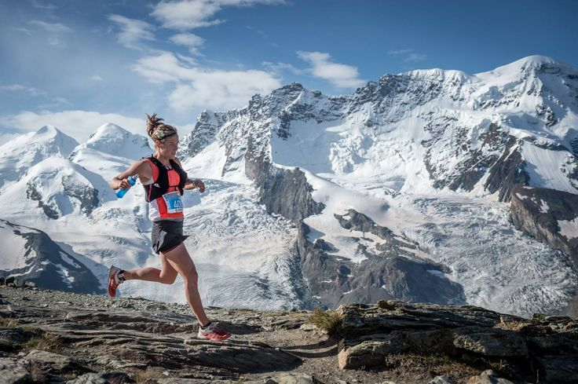
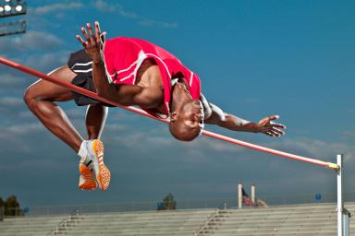
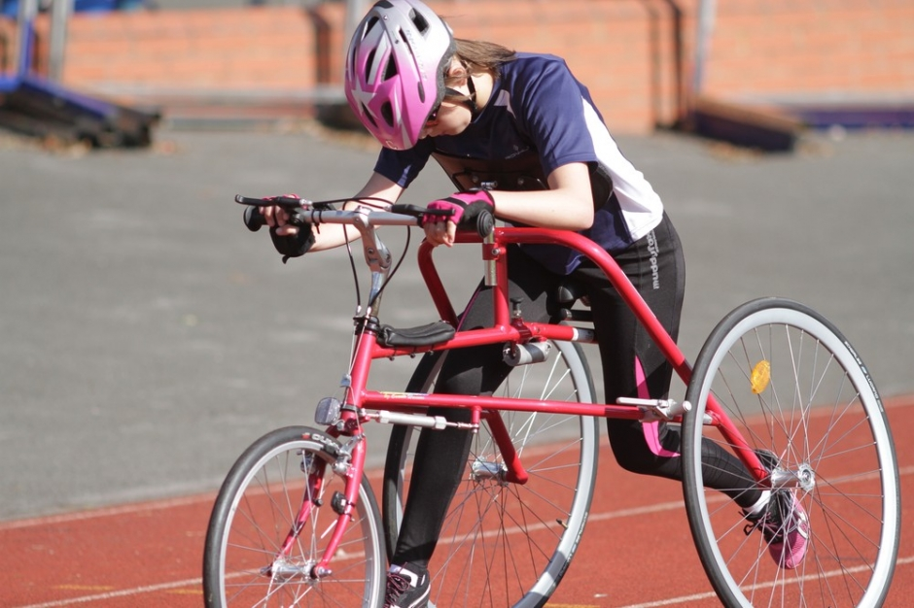
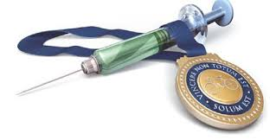
Notes:
So just to give you some examples of sport innovations….
Nanotech swimsuit (technological – elite sport)
Road running bikes (technological – inclusion of new groups/athletes)
Sky running (development of new sports)
Doping and new ways of cheating
Fosbury flop/highjump (new techniques, new ways to practice sport)

Slide 8
Figure 1: Sport Innovation Types (Tjønndal, 2016)

Slide 9
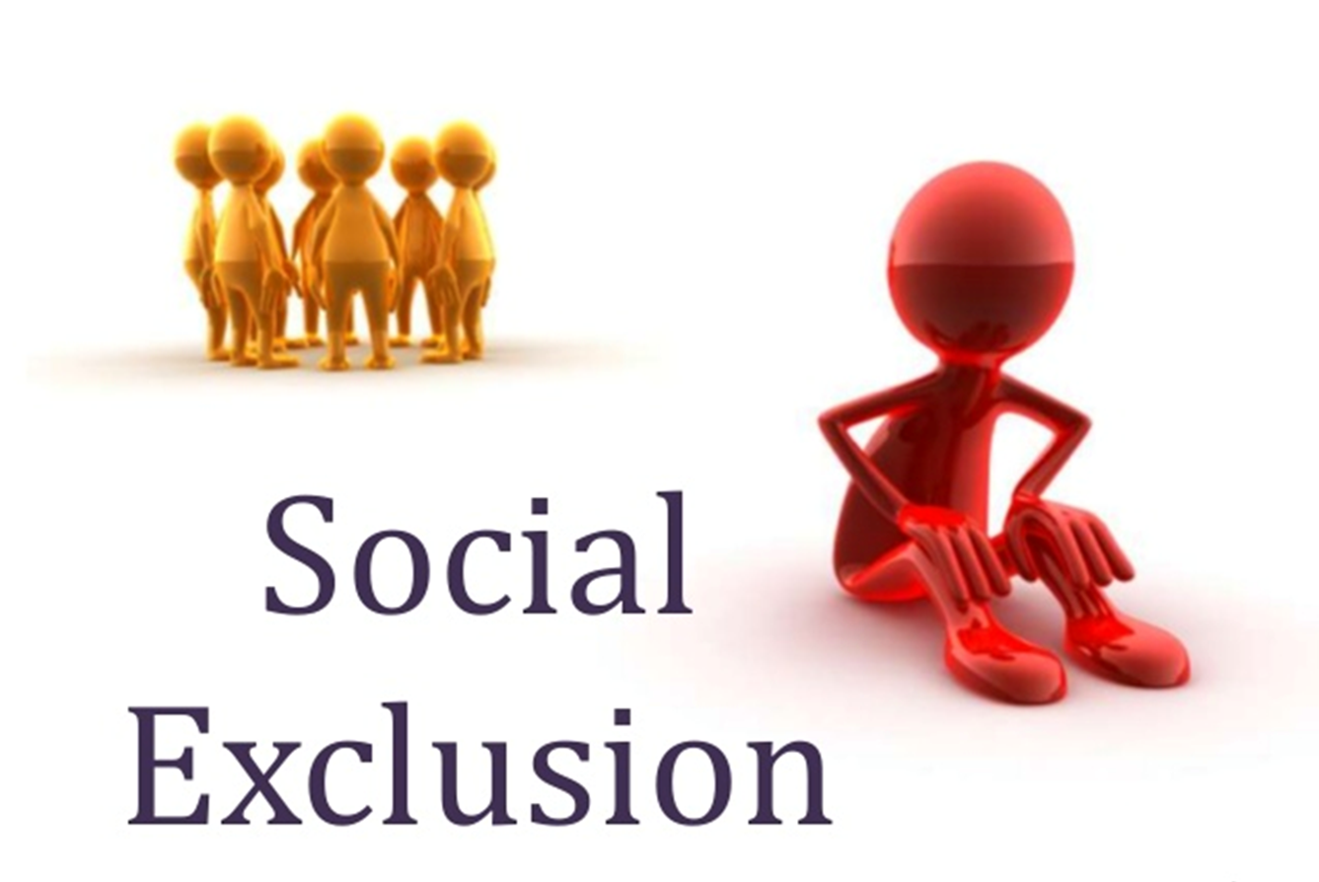
The link between innovation and inclusion
Innovations are crucial solutions to predefined challenges, problems and needs → Practices of social exclusion in sport
Gender
Social Class
Ethnicity
Religion
Age
Disability
Notes:
So what is the link between innovation and inclusion in sport?
Many innovation researchers argue that Innovations are crucial solutions to predefined challenges, problems and needs…
And for me, practices of social exclusion is one of many predefined challenges that modern sport face..
As I’m sure you all know, social exclusion in sport takes place on many different bases… it could be gender, social class, ethnicity, religion, age and disability to mention some…

Slide 10
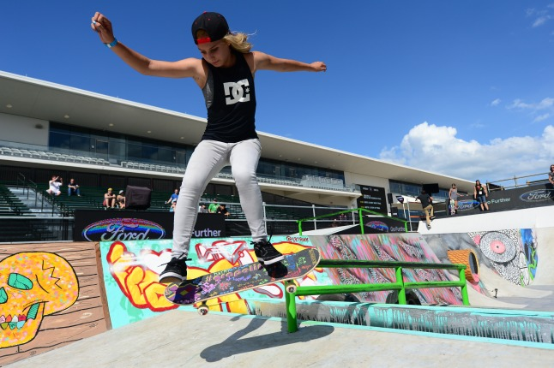
The case study: Skateboard and gender
Aim:
How, and in what ways, innovation can
promote the inclusion of girls and women
in male dominated sports?
Case: a Norwegian skateboard club
(coaches, athletes, leaders, parents)
Theoretical framework: Innovation litterature, social innovation theory
Notes:
So… Now I’ve talked a bit about the general background and theoretical foundation of my PhD project…
I would like to continue with one of the case studies, specifically, the case study of skateboard and gender..
The aim of this case study is to investigate:
«How, and in what ways, innovation can promote the inclusion of girls and women in male dominated sports?»
The case I use to study this is a Norwegian skateboard club. This includes coaches, athlets, leaderes and parents in the club…
And, as I’ve discussed previously, the theoretical concepts that I use to analyze this topic is derrived from innovation litterature and social innovation theory.

Slide 11
The ‘typical’ skateboarder?
Male
Young (12 – 30 yrs.)
Middle class
White
Notes:
SO… When most people think about skateboard (and as previous research has demonstrated), skateboarding is dominated by young men, often white and middle class…..

Slide 12
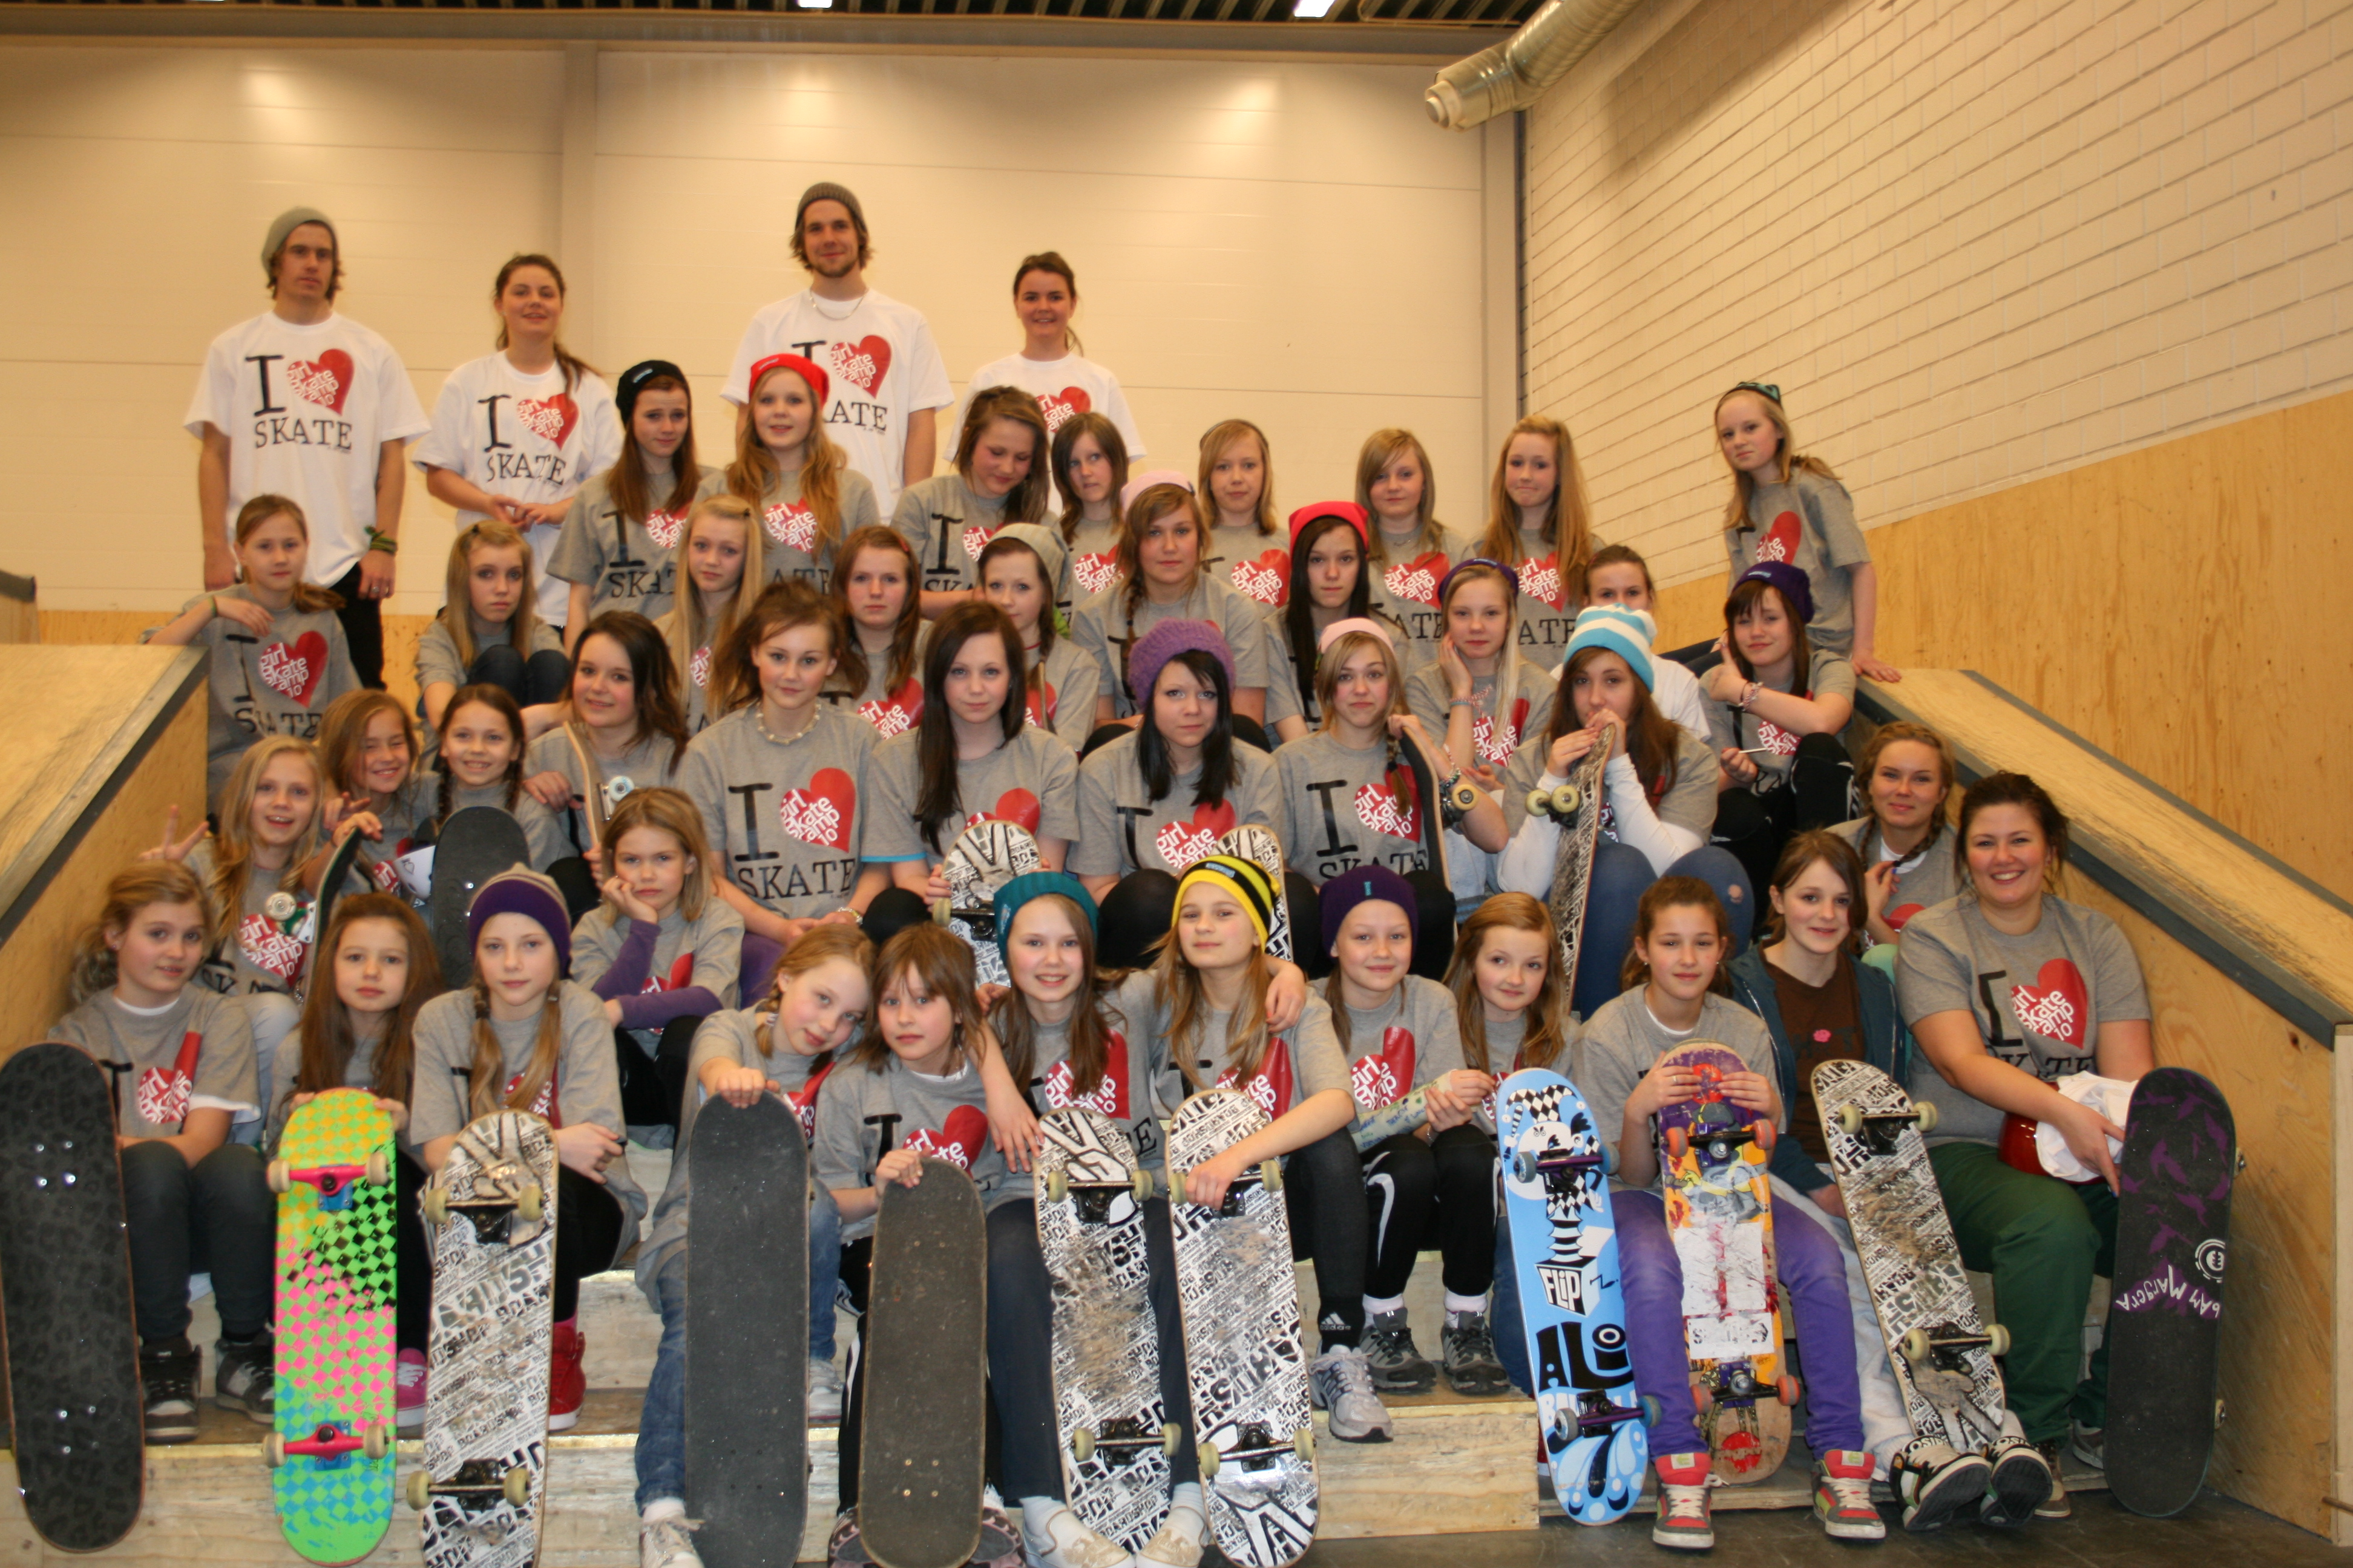
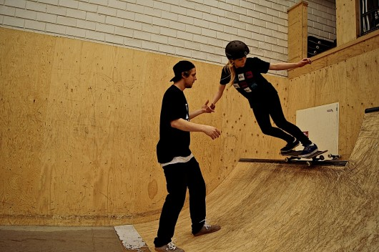
Methods
Unique Case (Yin, 2014)
Girl skate camp
Girl Skate
Kid skate
«Adult skate»
Field work: 6 months, still going..
- Participant observation (1-3 times a week)
Interviews (club leaders, coaches, skateboarders, parents)
Notes:
So in this study… I look at a local skateboard club which best can be described as a unique case…It is a club that recently has implemented significant changes (or innovations) to the practice of the sport.. This club, like the majority of skateboard clubs in Norway, has been dominated by male members. The leaderes and coaches of the club has recently introduced a number of changes to the way they organize their training sessions with a specific goal of including girls, women and «older adults» (over 33 years)..
For instance, they organize «Girl skate camps» twice a year, where girls and women from all over the country are invited to skate together. They also implemented «womens only» training sessions, as well as «kids sessions» and something they call «adult skate», which is for people over 35 only.
So, what I am doing to investigate the meanings of these social innovations - these changes to the club as a sport organization and to the practice of skateboard in the club – is field work.. For the last 6 months I have been doing field work, consisting of participant observations (1-3 times a week) as well as interviews with skateboarders, coaches, leaders and parents…

Slide 13
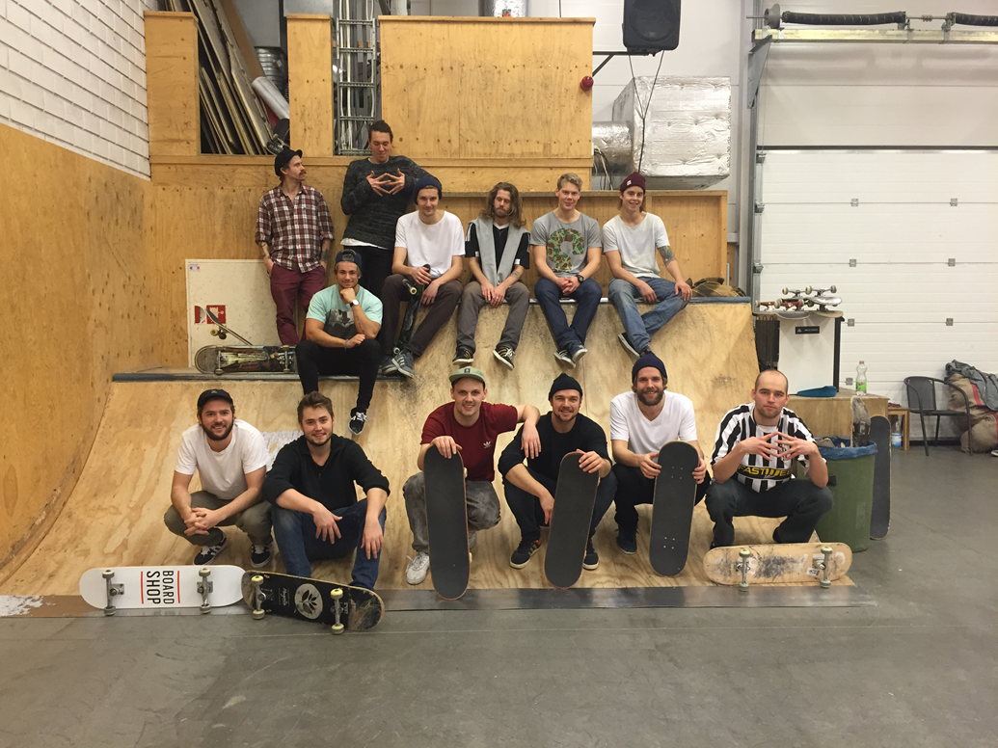
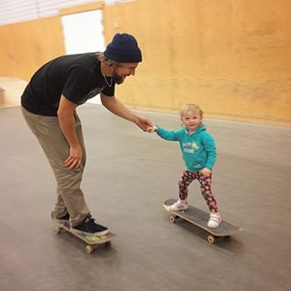
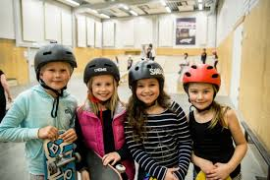
Changing the organization of sport activity to promote inclusion?
«Be the best skateboard club for girls and women in Norway»
«Promote skateboard for all, regardless of age, gender, ethnicity, religion or skill-level»
Notes:
So one of the main questions I keep asking myself during this study is – is this club changing the organization of their sport activity to promote inclusion?
Is it working, is it improvement? And if so, why is it working? What’s not working? What can other sport clubs learn from this?
This is innovation and social change from the bottom-up.. And that’s what makes it particularly interesting for me.
This club decided on its own that their main goal as a sport organization should be, firstly, to promote skateboard for all, regardless of age, gender, ethnicity, religion and skill-level
And secondly, that they should become the best skateboard club for girls and women in Norway.

Slide 14
Some current dilemmas….
Understanding what is going on… (outsider looking in)
Do these new skateboard activities and ways of organizing sport acitivity promote inclusion of girls and women?
Do they only help recruit female members or are the girls/women staying active in skateboarding, becoming fully integrated members of the skateboard club?
What potential can social innovations like these have for the organization and practice of sport? Potential to include marginalized groups? To change who participates?
Notes:
So…. I would like to finish with some current dilemmas I am reflecting on in this case study….
1) Understanding what is going on… (outsider looking in)
2) Do these new skateboard activities and ways of organizing sport acitivity promote inclusion of girls and women?
3) Do they only help recruit female members or are the girls/women staying active in skateboarding, becoming fully integrated members of the skateboard club?
4) What potential can social innovations like these have for the organization and practice of sport? Potential to include marginalized groups? To change who participates?

Slide 15
Thank you for listening!
E-mail: anne.b.tjonndal@nord.no
Website: annetjonndal.wordpress.com
Twitter: https://twitter.com/ATjonndal

